Slide 1
Arrays

Slide 2
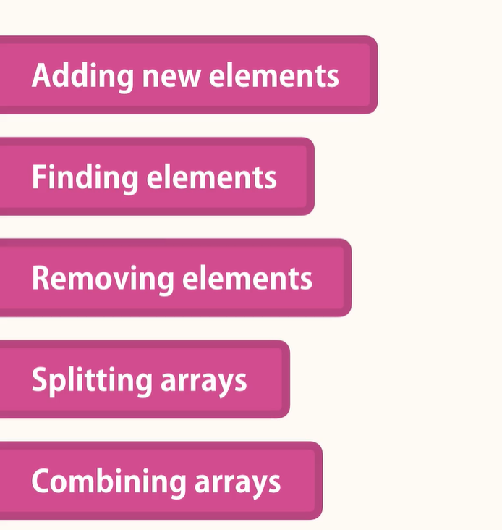
What we will learn about arrays

Slide 3
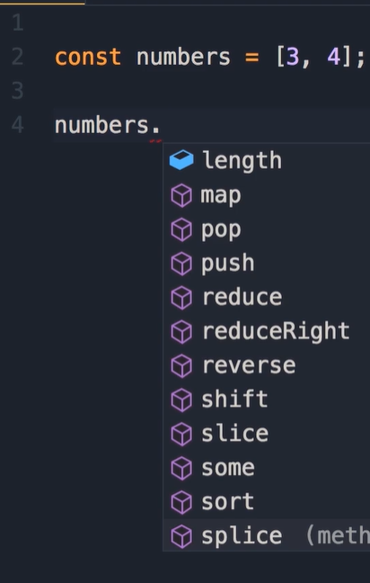
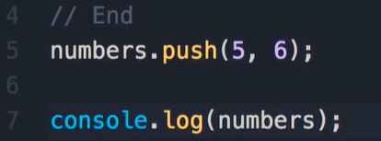
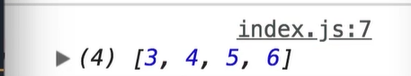
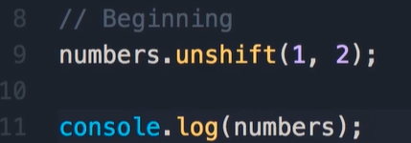
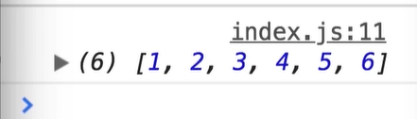
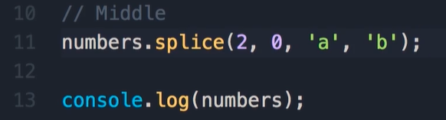
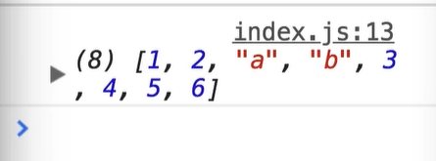
Adding Element (push, unshift, splice)
We already know that array is object

Slide 4
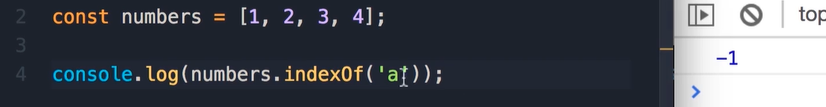
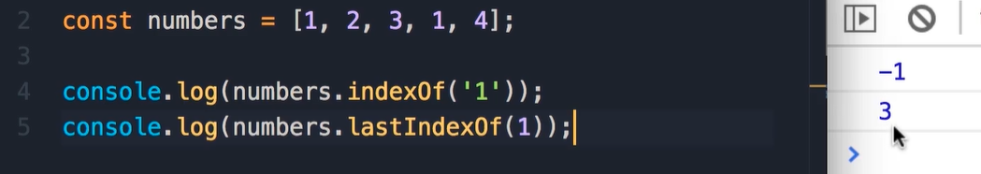
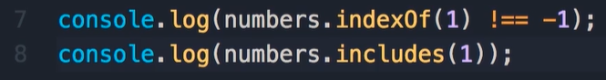
Finding Elements (Primitives types)
Check if element exist in array to ways if return true then the element is existed:

Slide 5
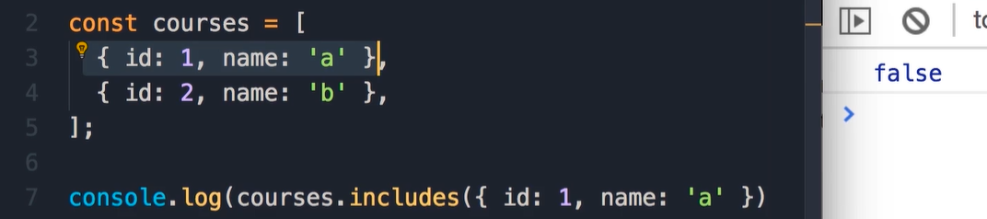
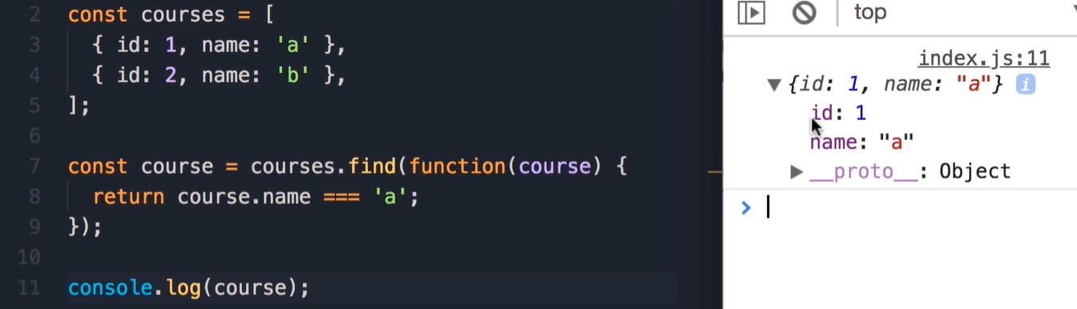
Finding Elements (Reference Types)
The reason why nits happening because the reference are checked and not the object Value.
In this case we have two deferent references than the result Is false.
If the element is not exist then
The return value will be undefined
Read more

Slide 6
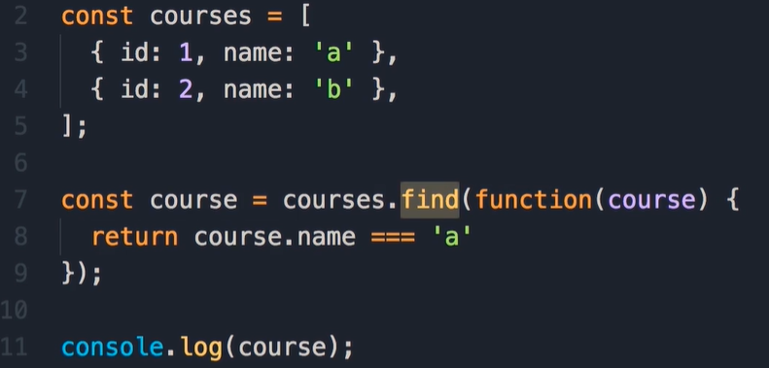
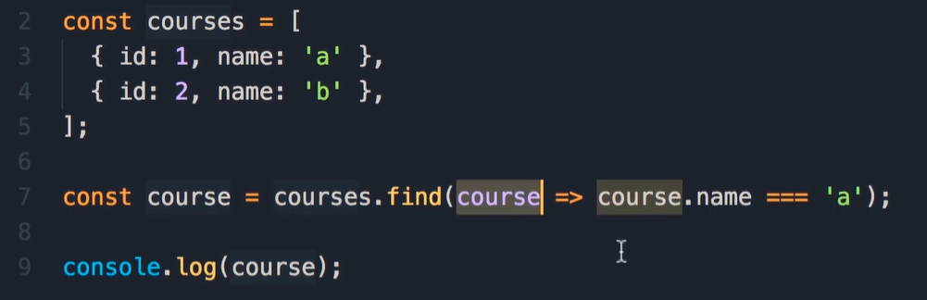
Arrow Functions
On the find method, in ES6 there is shorter and cleaner way to pass a function!
Before
After
Whenever you want to pass function as callback function or argument
for different method, you can use the arrow function syntax

Slide 7
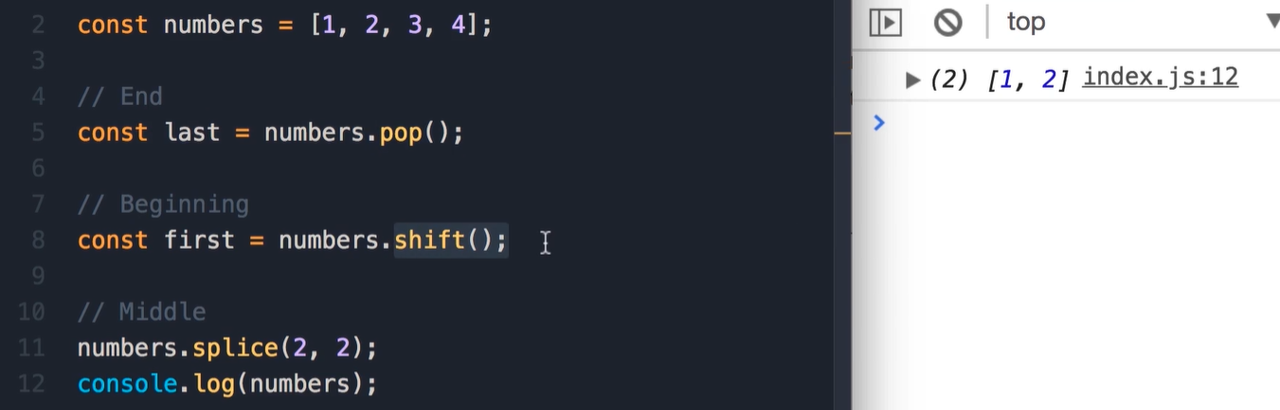
Removing Elements
Pop method to remove the last element.
Shift method to remove the first element.
Splice method to remove an element somewhere in the middle of array.

Slide 8
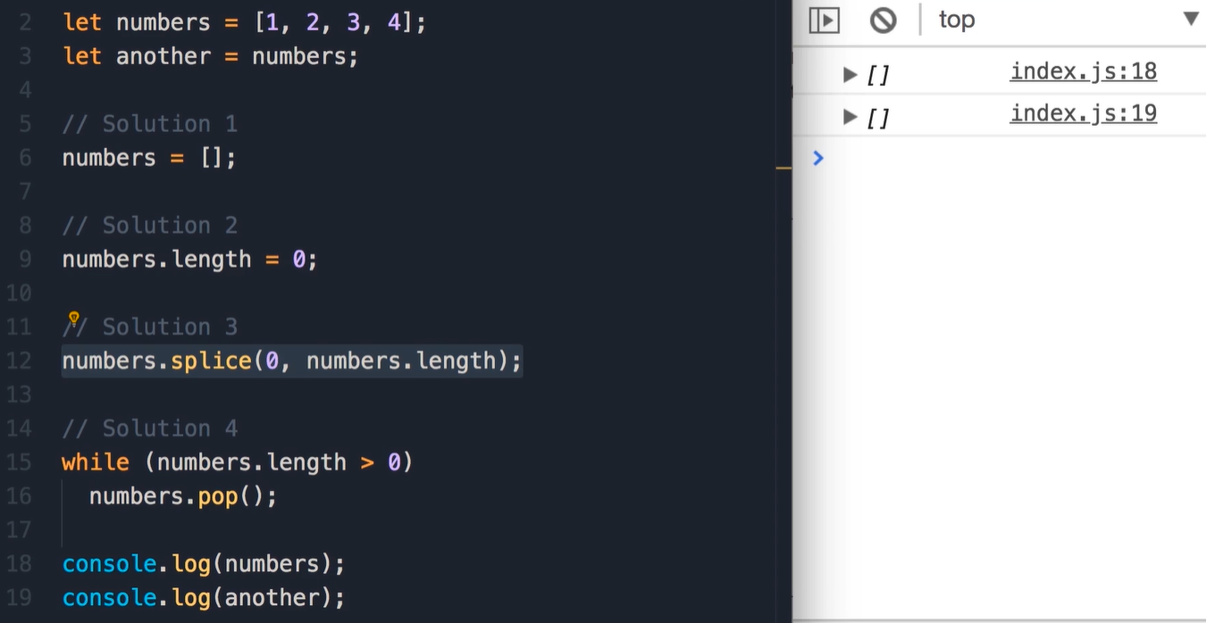
Emptying an Array

Slide 9
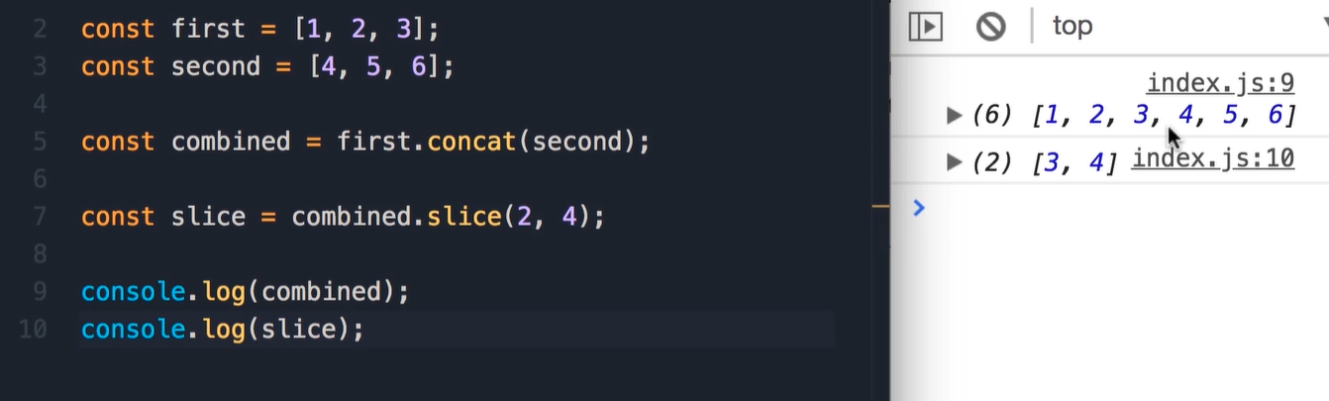
Combining and Slicing Arrays

Slide 10
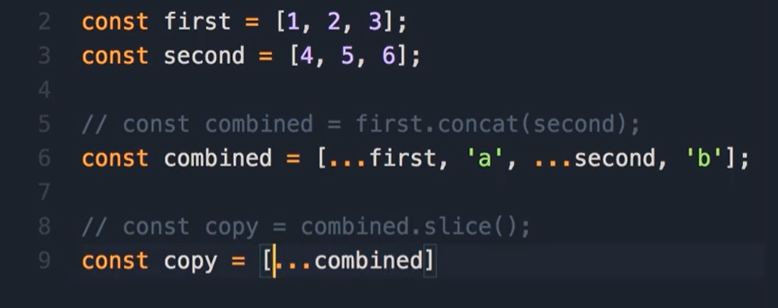
The Spread Operator in ES6

Slide 11
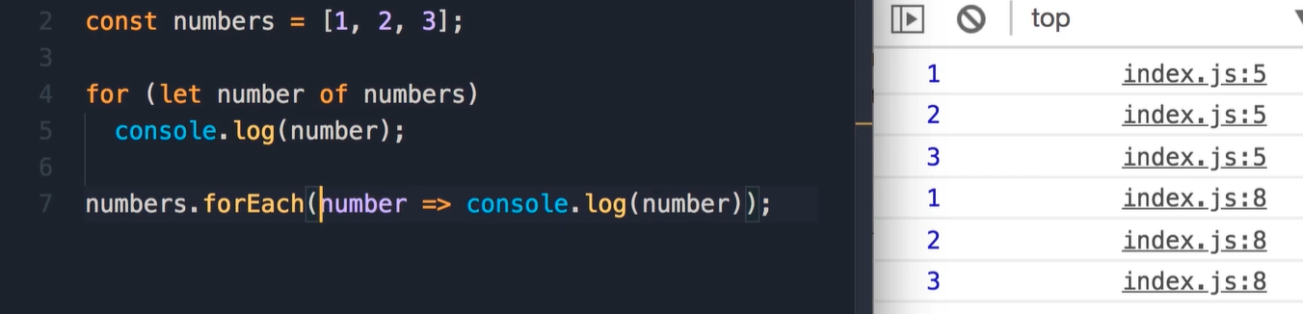
Iterating an Array

Slide 12
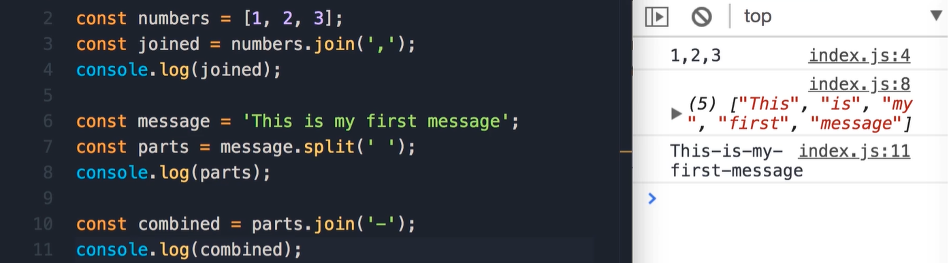
Joining Arrays

Slide 13
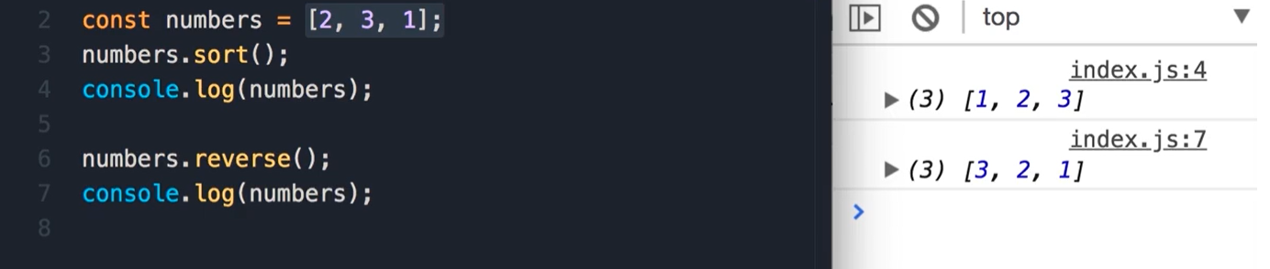
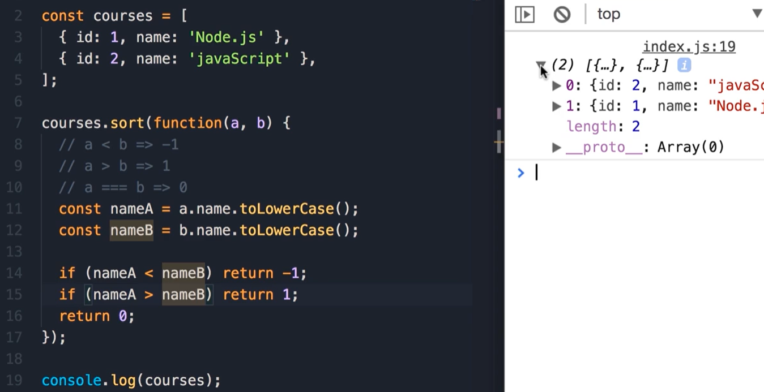
Sorting Arrays

Slide 14
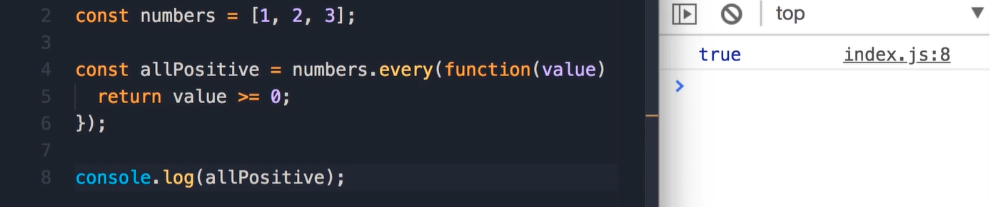
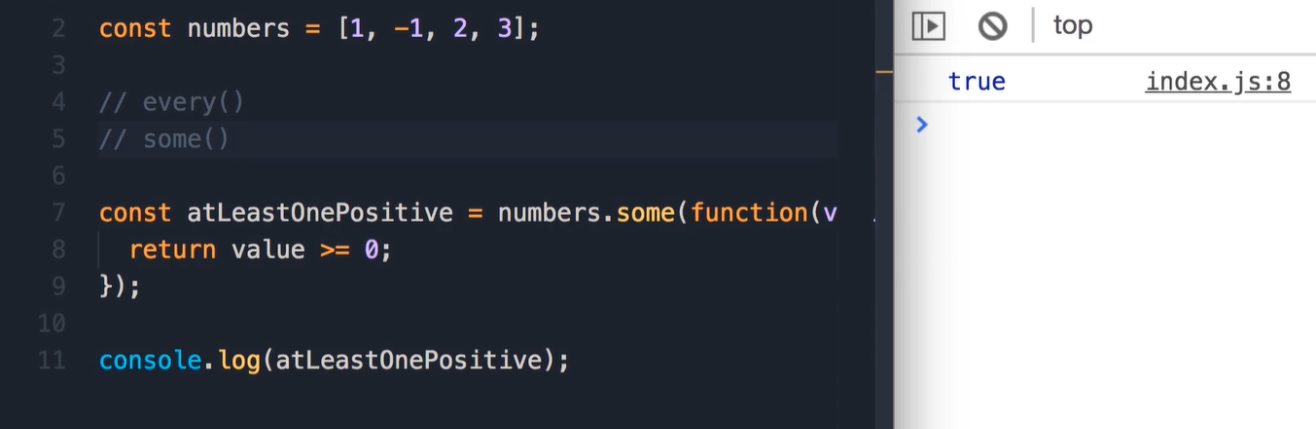
Testing the Elements of an Array
Every method will run over all the items and will stop once it received false

Slide 15
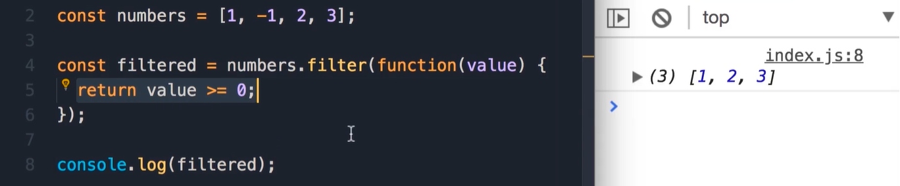
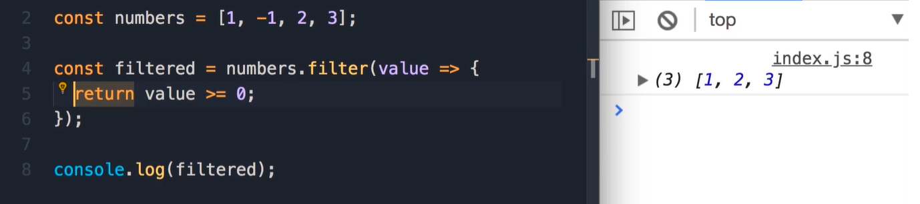
Filtering an Array

Slide 16
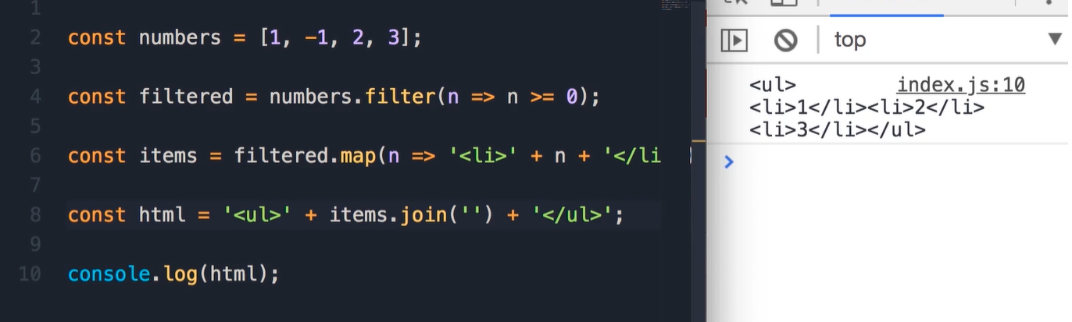
Mapping an Array

Slide 17
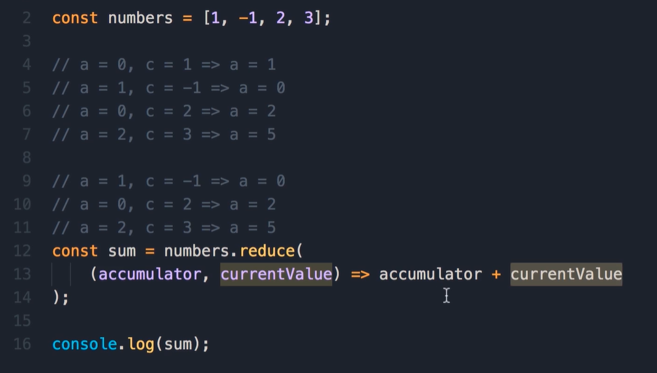
Reducing an Array

Slide 18
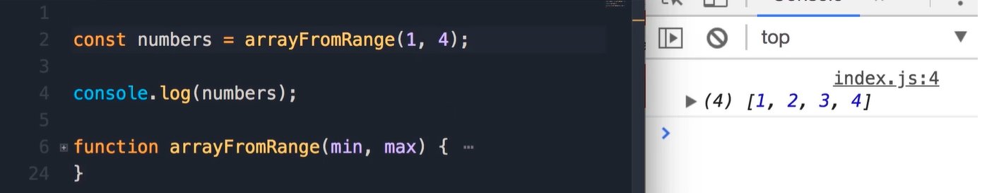
Exercise 1- Array from Range
Implement function arrayFromRange

Slide 19
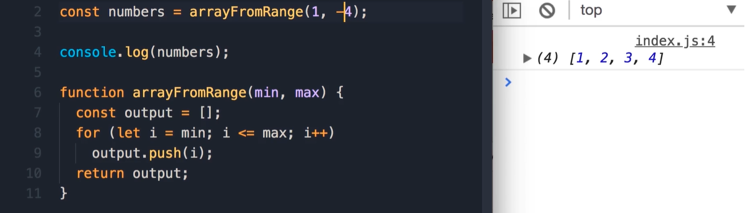
Solution

Slide 20
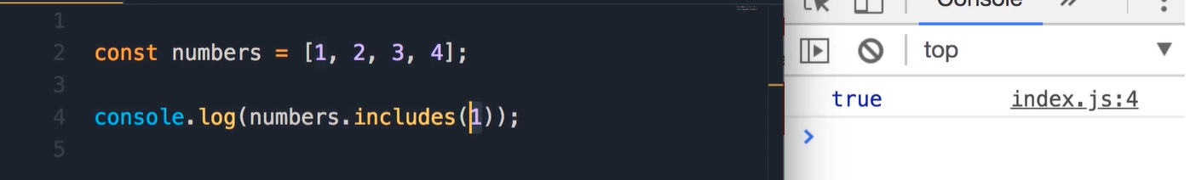
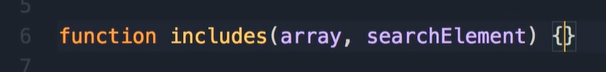
Exercise 2- Includes
Implement Include method return true/false

Slide 21
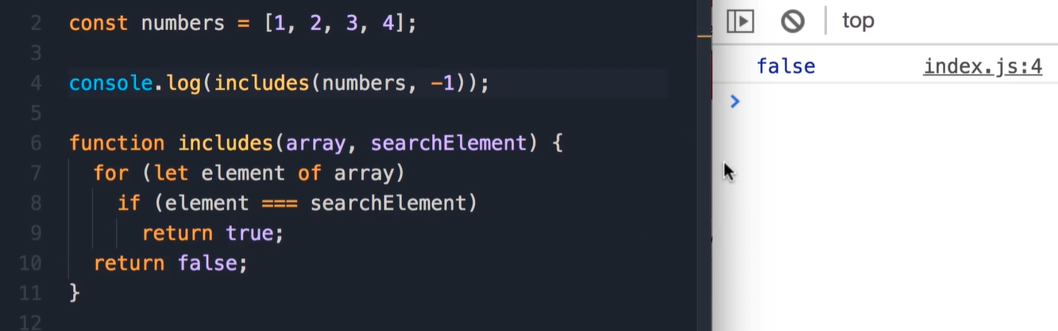
Solution

Slide 22
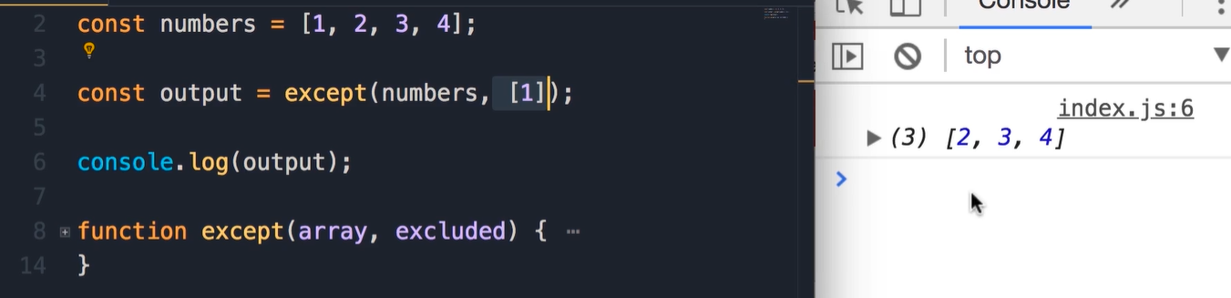
Exercise 3- Except
Function take two array , that return new array except the second one
Implement the except function.

Slide 23
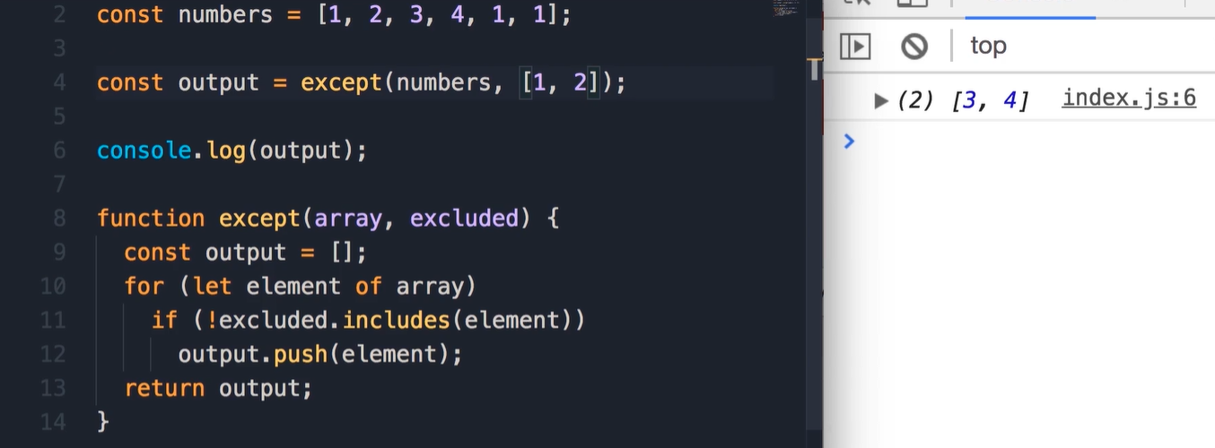
Solution

Slide 24
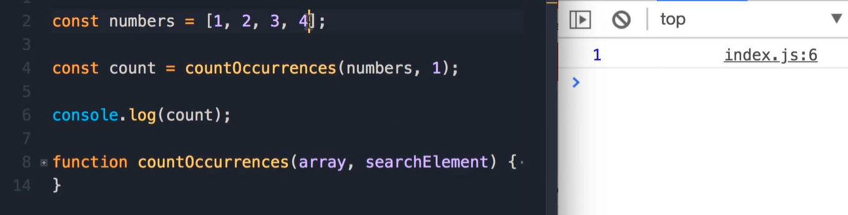
Exercise 4- - Count Occurrences

Slide 25
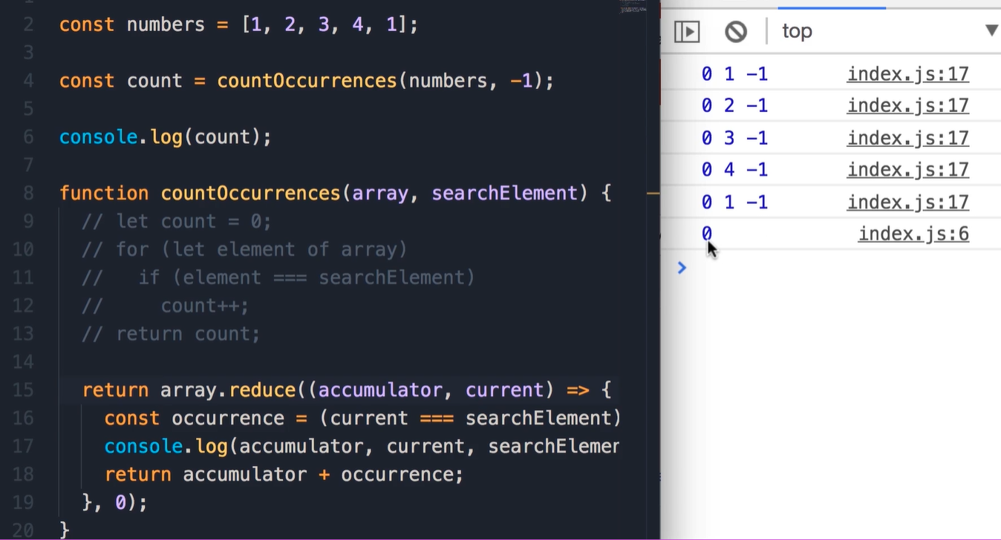
Solution

Slide 26
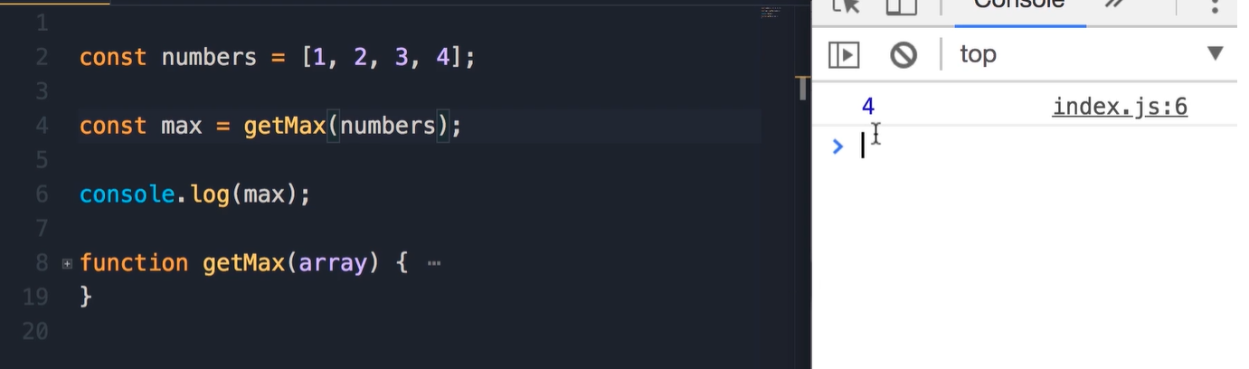
Exercise 6- Get Max

Slide 27
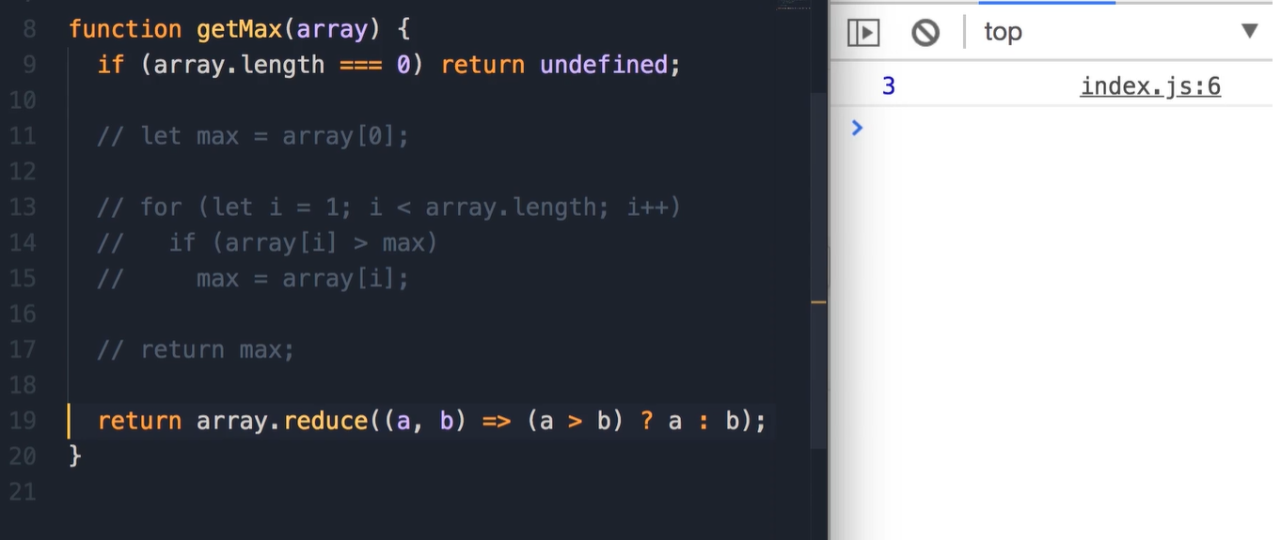
Solution

Slide 28
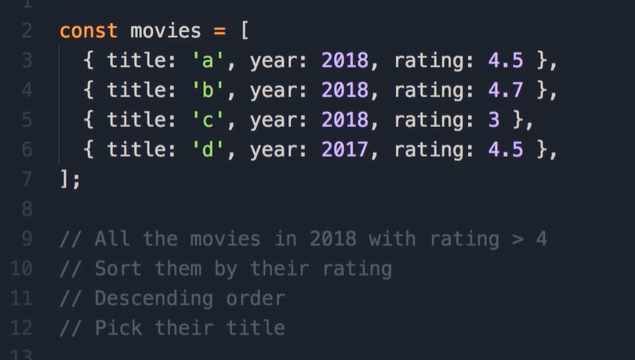
Exercise 7- Movies

Slide 29
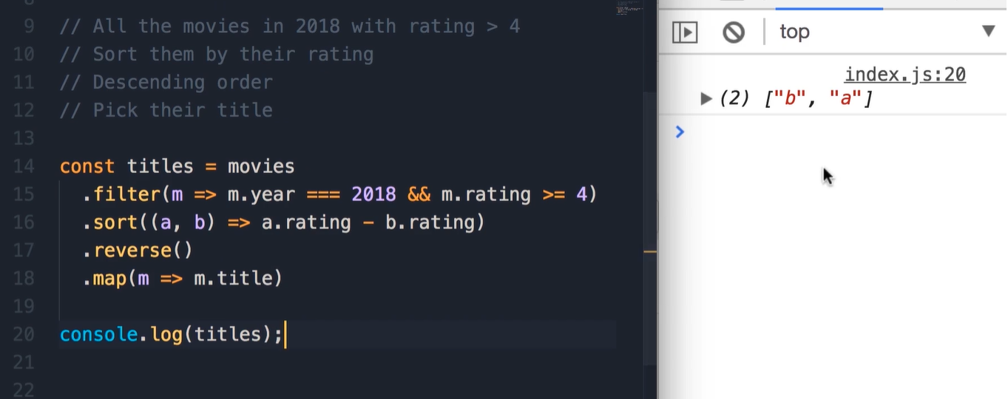
Solution

Slide 30
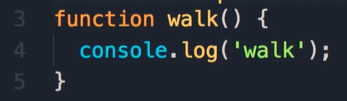
Functions

Slide 31
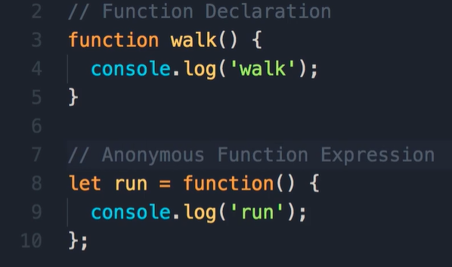
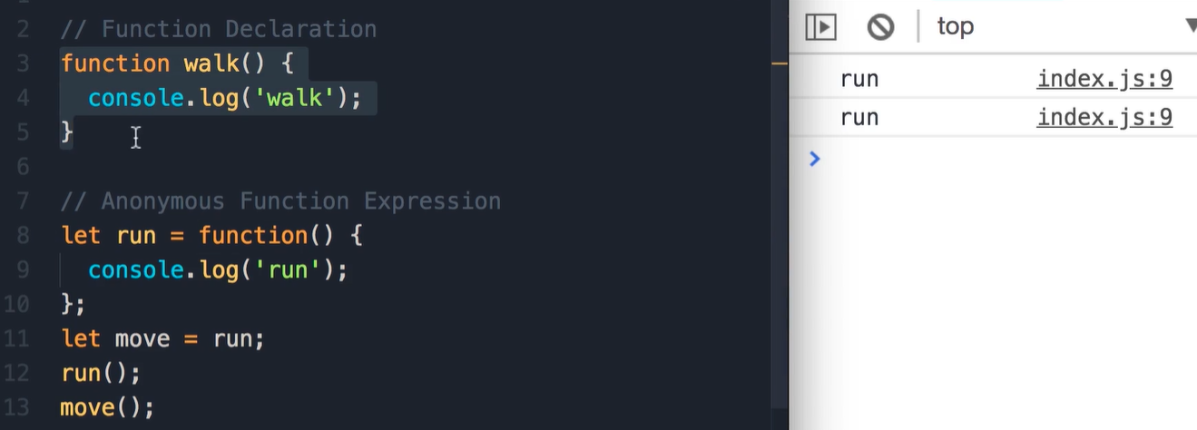
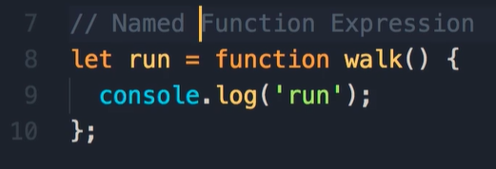
Function Declarations vs Expressions
There is two ways to declare a functions:
Function Declaration
Function Expression

Slide 32
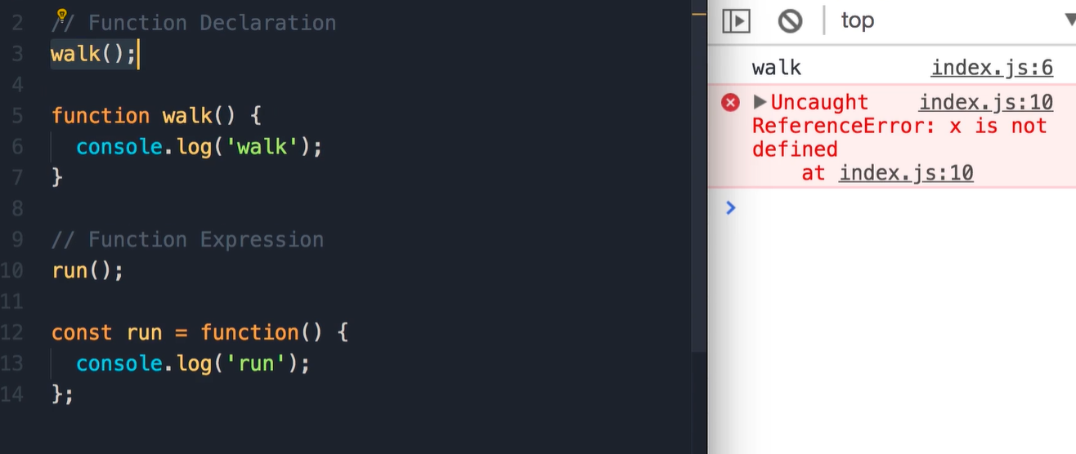
Deferent between Function declaration (FD) and Expressions Functions (EF)
In FD u can call the function before the definition of the function.
Why this happen!, because the JavaScript engine before execution the code take all functions
And put them at the top of the document. And that what we called (Hoisting).

Slide 33
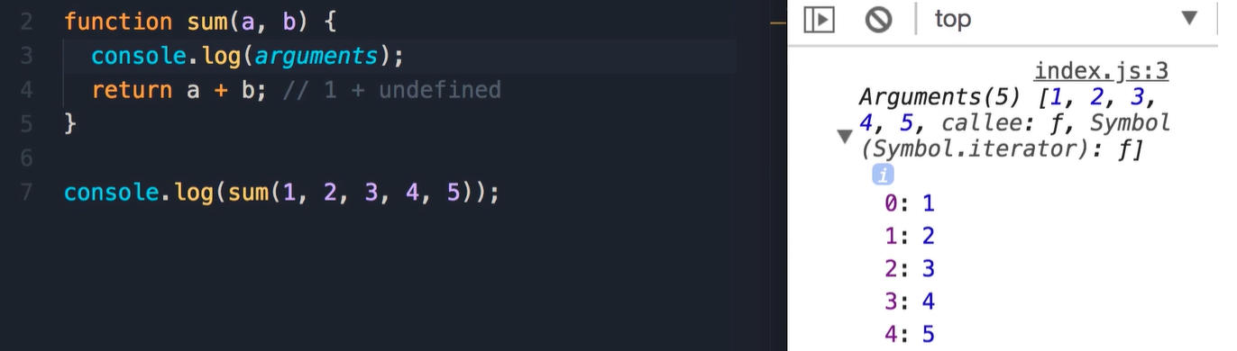
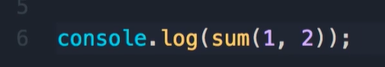
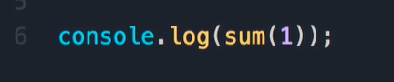

Arguments
The argument in function are dynamics types
In JavaScript u can pass less argument in the function, by default the value will be undefined
We can pass additional argument to the function JavaScript will ignore the rest of undefined.
Every function in JavaScript have a special object is arguments

Slide 34


The Rest Operator
Rest operator … convert all the input that we are sending to function to array of values

Slide 35

Default Parameters

Slide 36

Getters and Setters

Slide 37

Try and Cath

Slide 38


Local Scope
The scope is about where the variable is accessible

Slide 39


Global Scope

Slide 40


Let vs Var
Var is accessible in all the body of the function

Slide 41


Let vs Var vs Const

Slide 42

this keyword
`this` reference to the object that is executing the current function.
Example of the method object:
If we use this inside an object its reference to the current object
If we use this globally, this reference to global(window in browser, and global in node)

Slide 43

this keyword
Example of the global object

Slide 44

this keyword
Why we see the window object shouldn’t this reference to the video object?
NO Because here we are inside this callback function, this function is just a regular function its not a method in the vide object

Slide 45


Changing this
Using self definition and use it instead of this inside the function.
Using bind method on the function

Slide 46

Changing this using the arrow function this is the modern way

Slide 47

Exercise 1- Sum of Arguments
Accept numbers or array and return the sum
As part of this exercise u need to detect of the argument is array to do that u need to use Array.isArray() method.

Slide 48


Solution
To have a varying numbers of parameters, we use the rest operator, and the rest operator will convert them all to an array, So we have an array.

Slide 49



Destructuring

Slide 50


Destructuring

